Slide 1
用Spring Boot编写RESTful API
Spring Security
用Spring Security保护
RESTful API的例子

Slide 2
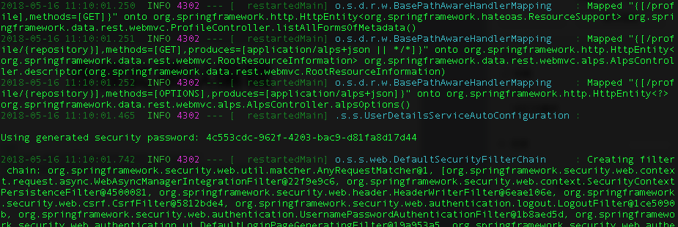
启用Spring Security
<dependency>
<groupId>org.springframework.boot</groupId>
<artifactId>spring-boot-starter-security</artifactId>
</dependency>

Slide 3
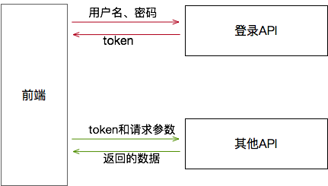
前后端交互
Open Auth Server
OpenID Server
Filter
token -> User

